Slide 1
Structure Investigation of Fam20C, A Golgi Casein Kinase
Sharon Grubner
National Taiwan University
Week 8 report – August 26th, 2013

Slide 2
My Research Project
The broad aim of this research project is to investigate the structure and function of a unique secreted Golgi casein kinase, FAM20C.
Mutations in FAM20C lead to osteoclerotic bone dysplasia in humans, also known as Raine syndrome.
Raine syndrome is characterized by ectopic calcification which increases bone density and often causes death in neonatal stages.
Studying the structure and specifically the ATP binding pocket of FAM20C would allow to better understand its function and better control it for experimental purposes, and perhaps for a later drug discovery project.

Slide 3
Progress
FTProd
Confirmed my ‘consensus’ sites analysis with my mentors and repeated part of the binding sites analysis
VolMap
Confirmed my water occupancy results with my mentors
Continued qualitative analysis and writing my final report
My progress is being updated on a daily basis and shared with my mentors on Evernote.

Slide 4
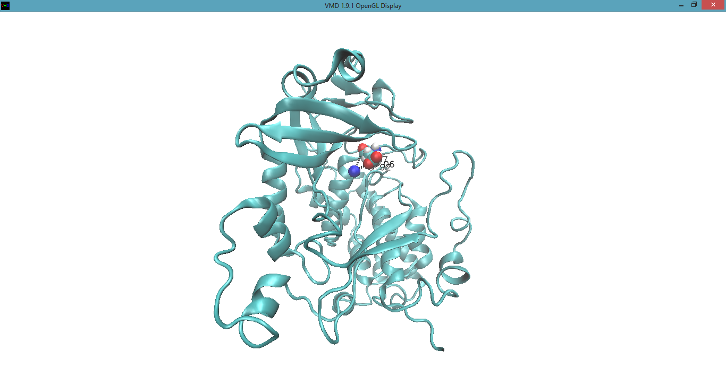
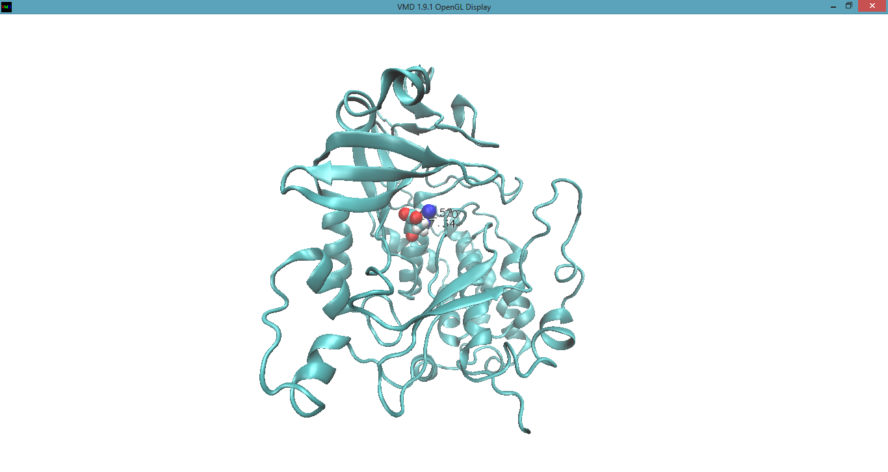
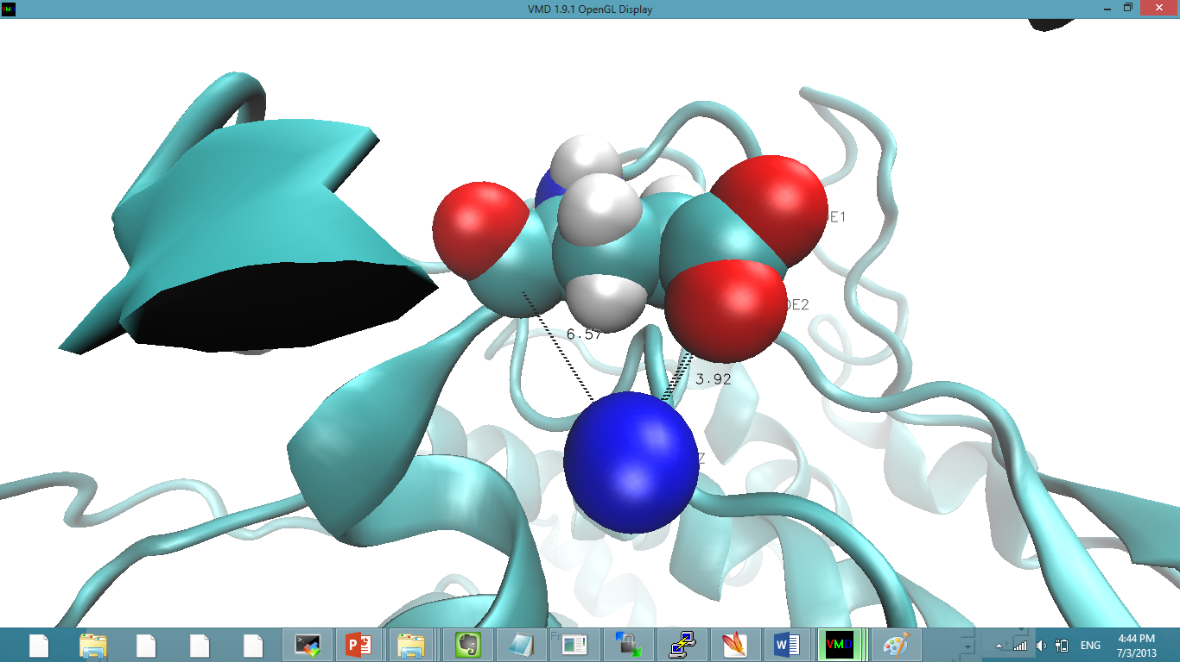
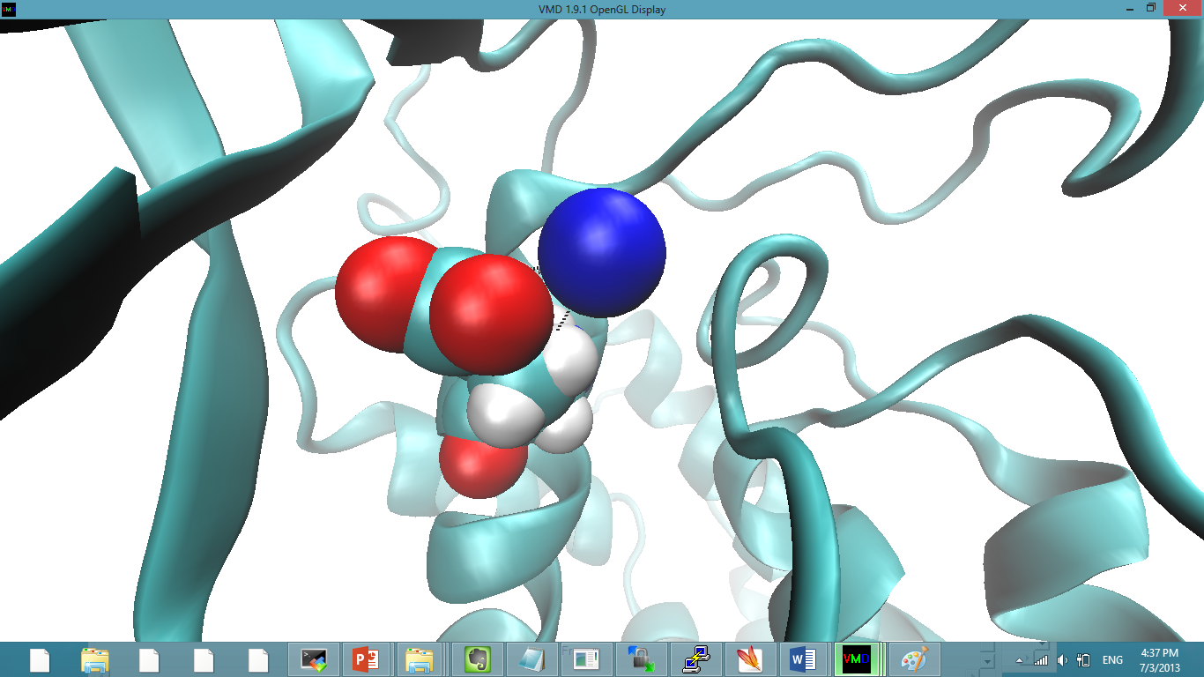
Results Salt Bridges
Bond lengths between K192-E218
Bond lengths between K192-E213

Slide 5
The salt bridge interactions between the conserved residues analyzed ensure the coordination with the ADP phosphate in order to facilitate binding and activation of the kinase.
The analysis shows that K192-E218 salt bridge interaction, of less than 4Å, exists 71.8% of the simulation time, while K178-E213 salt bridge interactions exists 66.1% of the time.
These results are interesting since they show that alternate conformation is possible between these pairs and could be exploited for drug design.

Slide 7
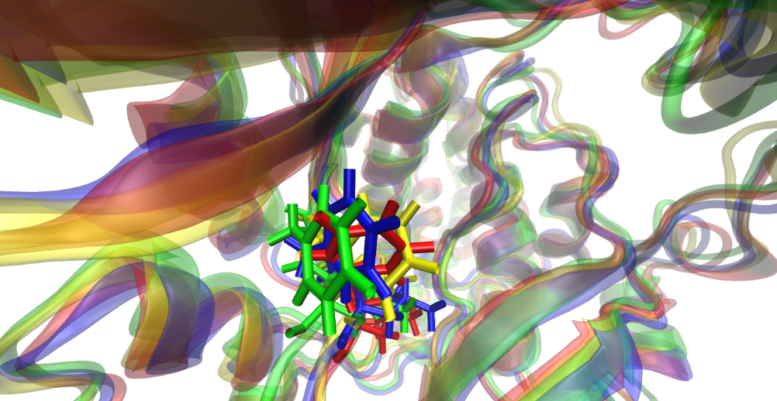
The Hinge
Frames 500, 1000, 2500 and 4000 aligned by CA, Phe297 and Leu 298 highlighted (500 green, 1000 yellow, 2500 red, 4000 blue):
The Phe297 ring seems to be moving quite a lot and shows flexibility at the binding pocket hinge. The movement of the hinge’s ring allows to observe how flexible it is for drug design purposes.

Slide 8
The ADP Pocket Opening – Distance Between Loops
The opening and closing of the ADP bindng pocket was measured by the distances between the alpha carbons of the pairs G173-H308 and H174-H369

Slide 9
RMSF of Loop Residues
To observe the fluctuation in the ADP binding pocket’s two major loops- the P loop and the C terminal lobe- the RMSF values were calculated separately for both of the alpha carbons of these loops.
It is shown in the following figures that the fluctuation of the C-terminal lobe residues is overall higher than the P-loop residues fluctuation.
flexibility around the ADP binding pocket indicates it is accessible and allows maximization of the number of contacts between the ligand and the binding pocket residues during binding.

Slide 10
Water Occupancy
Water occupancy at the ATP binding pocket was analyzed using VolMap plug-in in VMD by changing the isovalue range.
Areas with high water occupancy usually mean excellent candidates for drug binding sites.
Hinge residues Phe 297 and Leu 298 – isovalue 0.55, i.e. there is water at that binding site 55% of the simulation time
P-loop and more specifically residue 171 - isovalue 0.60-0.65
R367 - isovalue 0.70
Salt bridge K178-E213 - isovalue 0.65
Salt bridge K192-E218 - isovalue 0.80, which corresponds to the finding of it being a relatively permanent salt bridge throughout the simulation

Slide 11
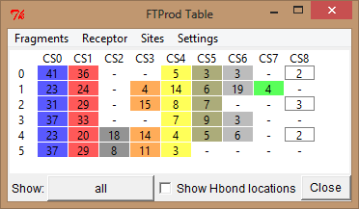
FTProd
Hinge binding site
Permanent interactions: polar interaction with the hinge
Highest rank in 4/6 frames, but ranked high in the other two frames
Polar interaction with active site residues Gly173- Gly174 and Glu325- Gln327 from both sides simultaneously. ranked second at 4/6 of the frames, in frames 323 and 3003 ranked first.
Polar interaction with salt bridge Lys192-Glu218 is relatively transient - in 3/6 frames
P-loop binding site- a little more transient, exists in 4/6 frames
Polar interaction around residues Val177-Lys178 is in 3/4 frames
The other interactions are relatively transient
ATP pocket binding site, opposite to the hinge
Polar interaction with Arg306 in 4/6 frames
Transient polar interaction around residue Phe209 in 2/6 frames
Average Link clustering method, 9Å cutoff

Slide 12
Future Goals
Prior to my departure:
Complete my final report
Possible next steps for the project:
Virtual screening of small molecule libraries
Predict sets of compounds that may be new inhibitors
AutoDock
Produce a list of compounds that will be ranked for experimental testing for the Dixon lab

Slide 13
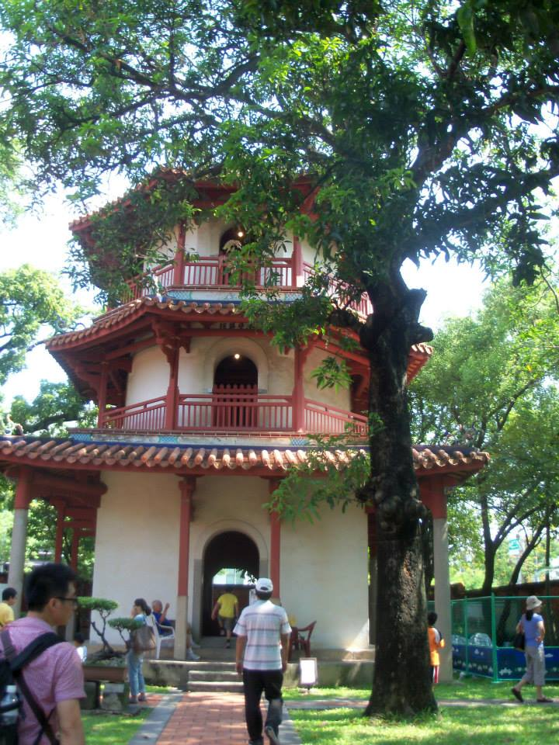

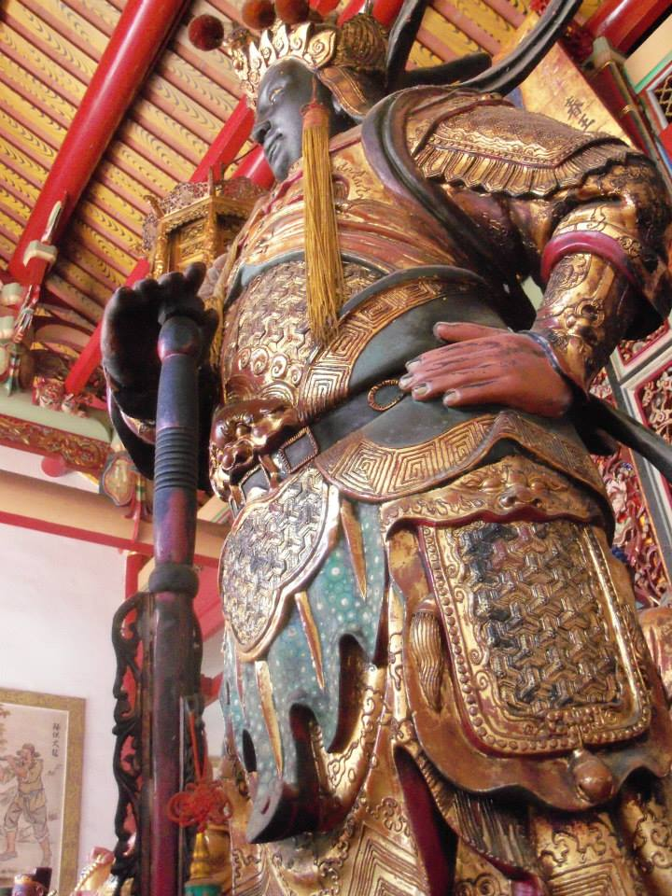
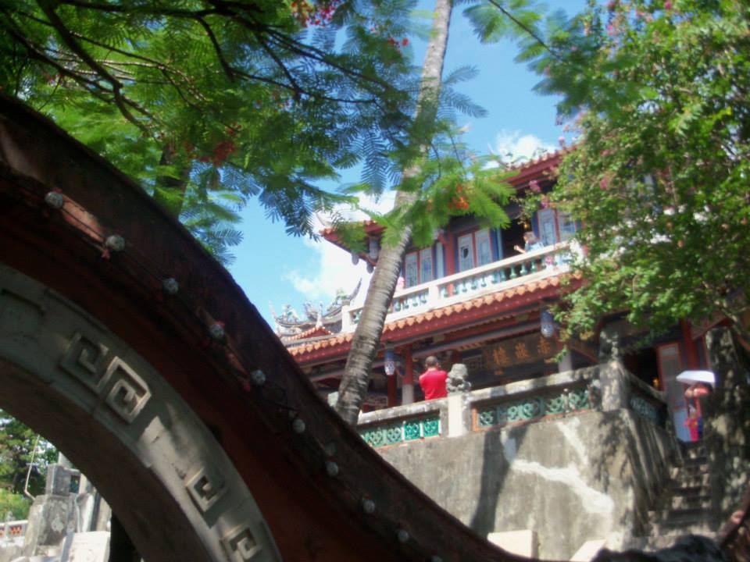

Culture
Tainan

Slide 14
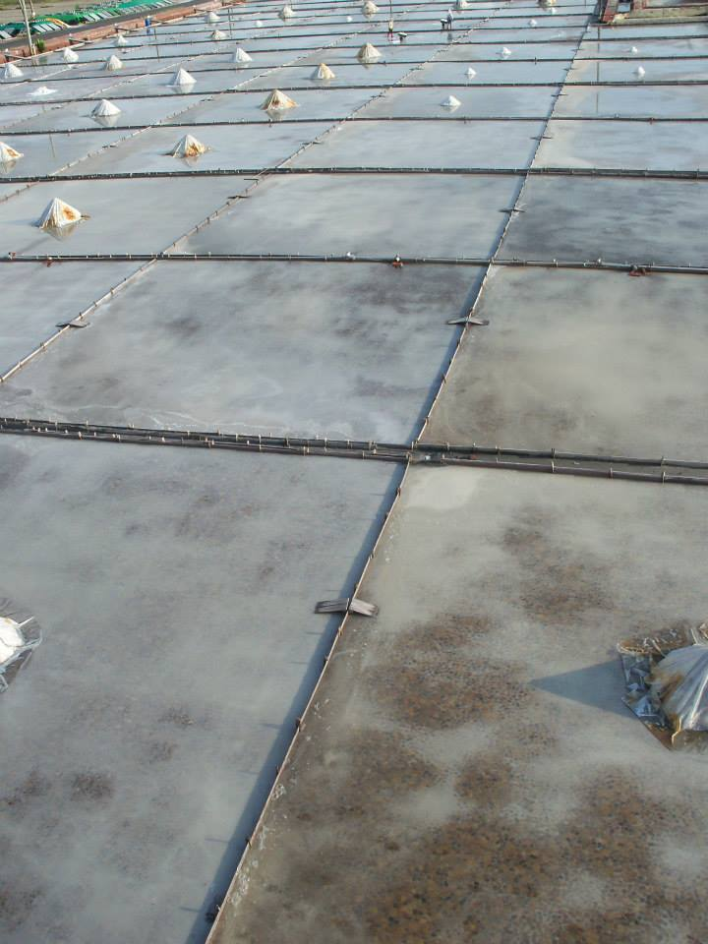
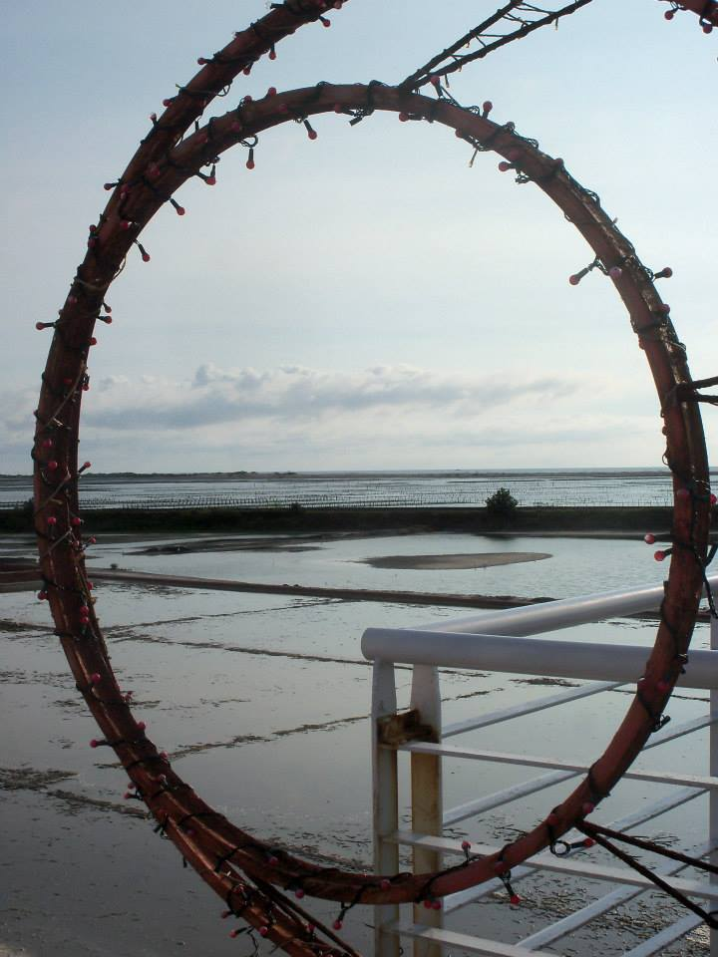
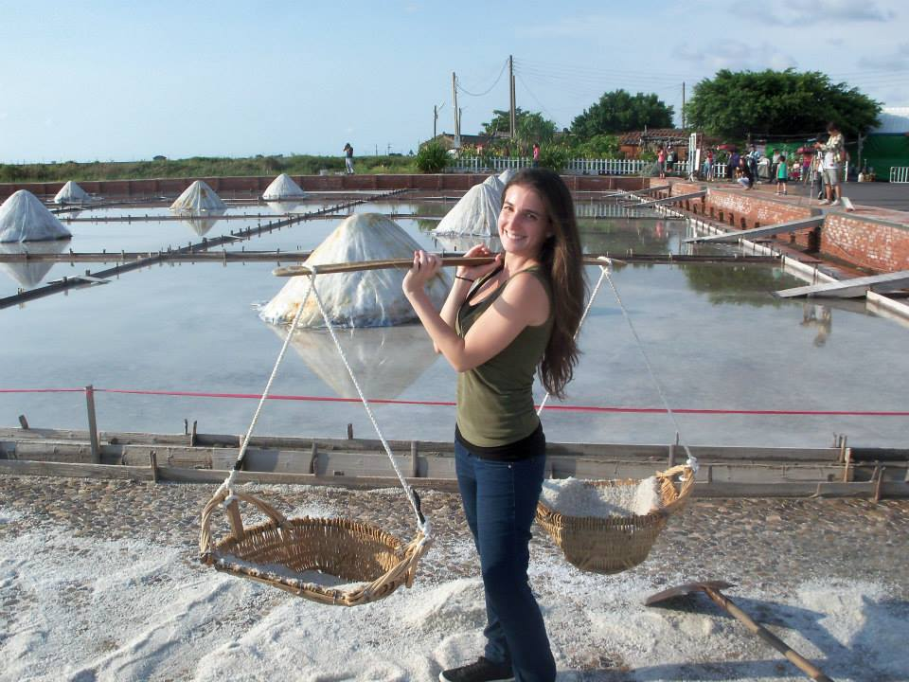
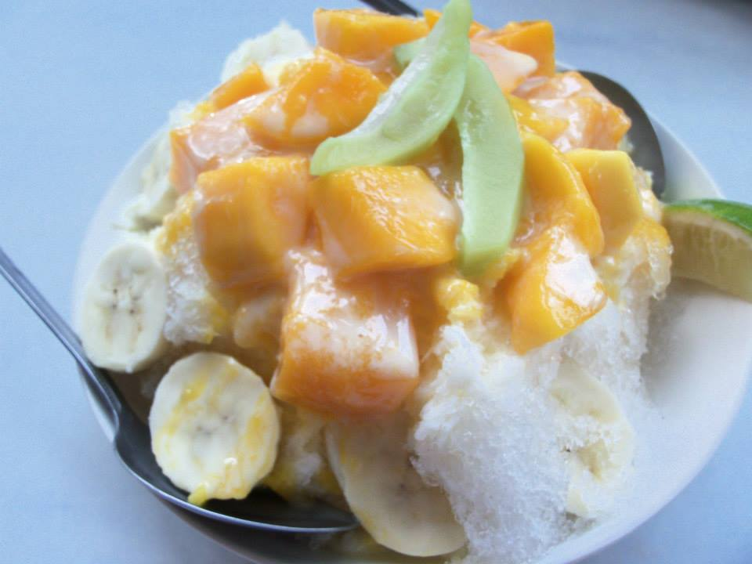
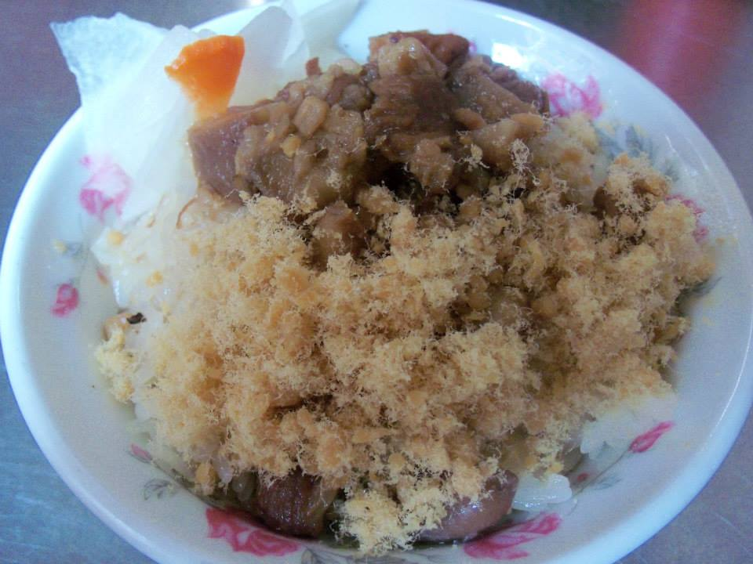

Slide 15
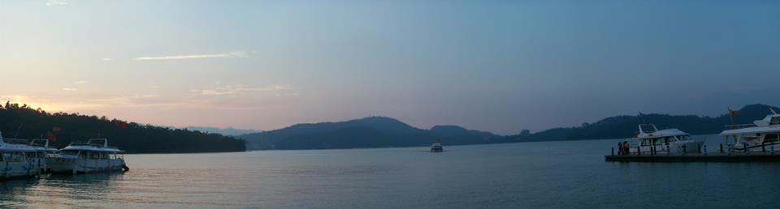
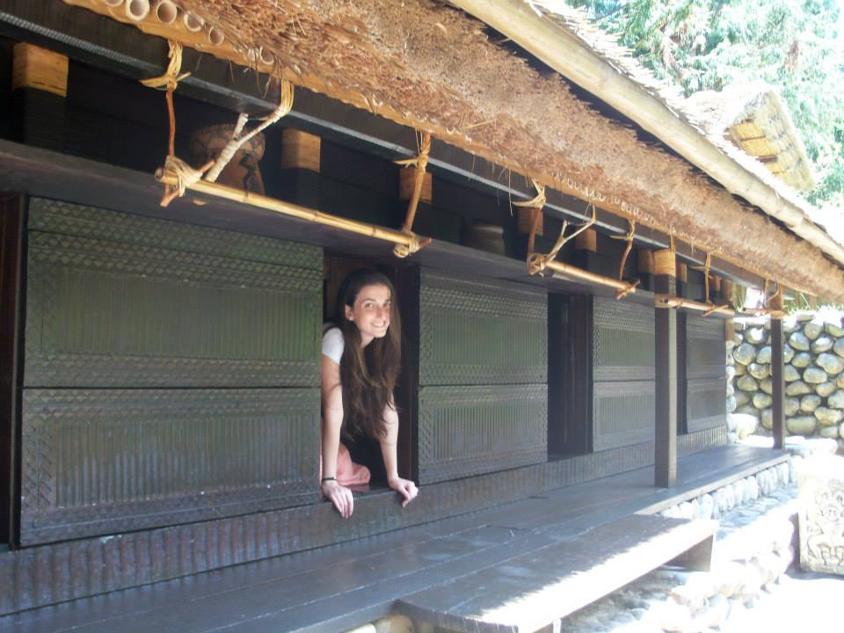

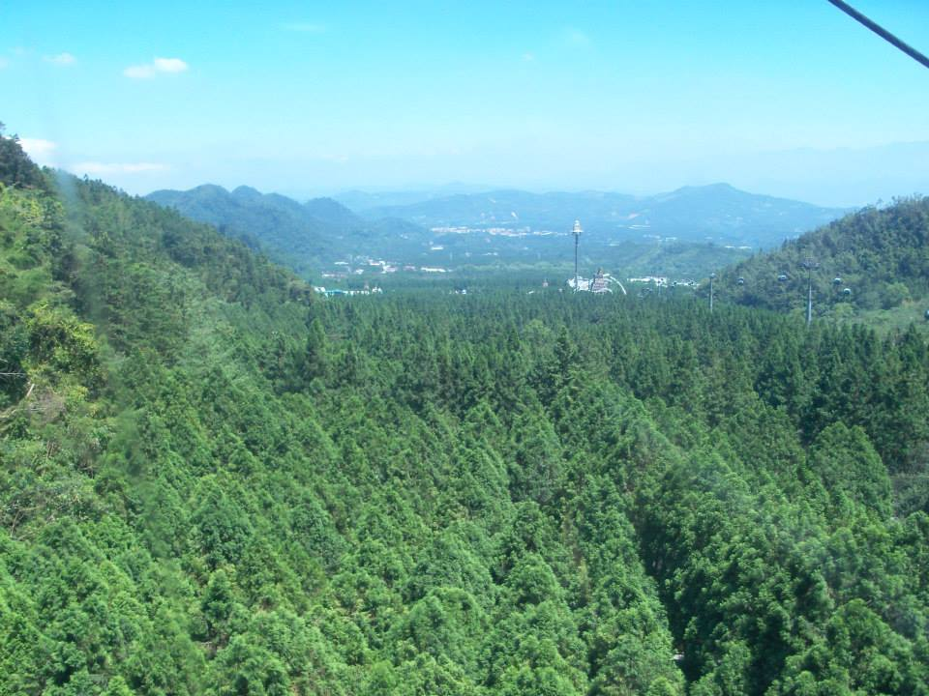
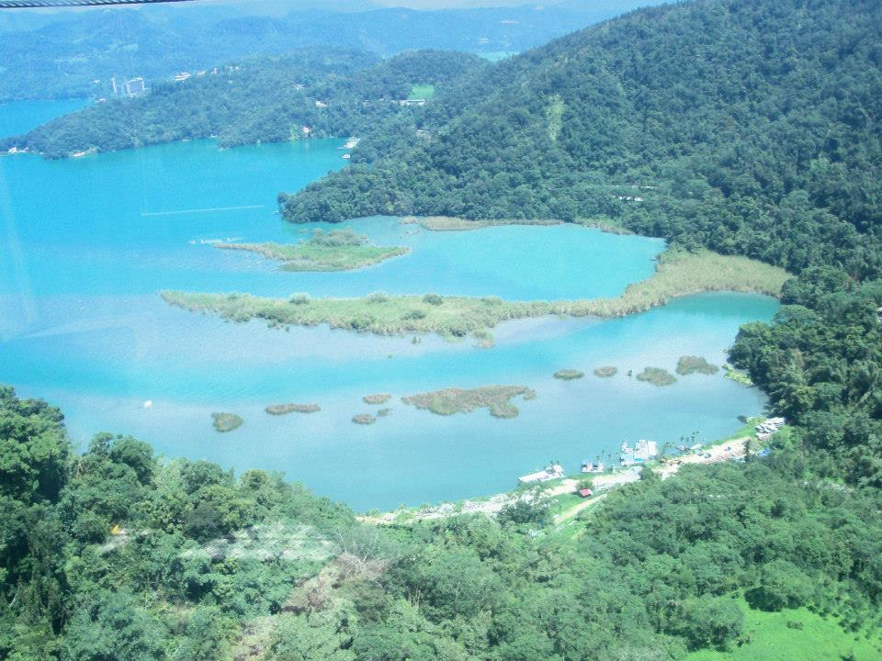
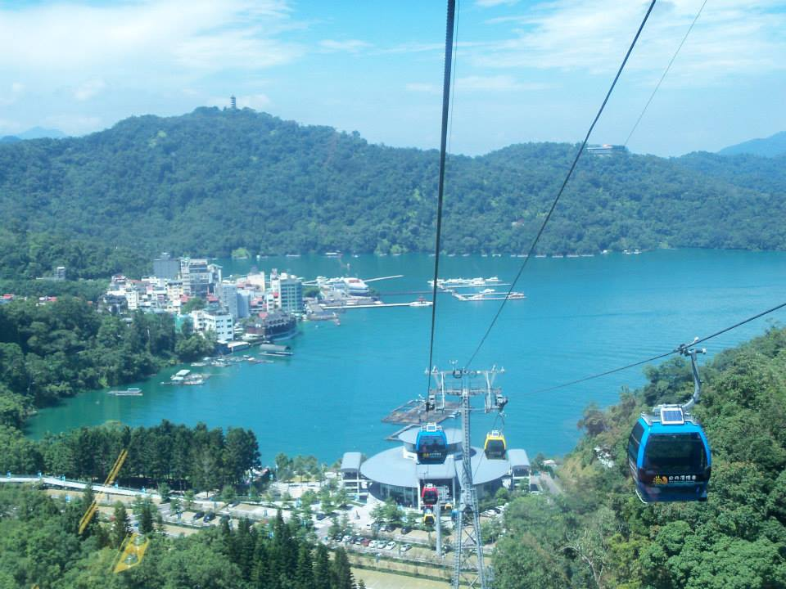
SUN MOON LAKE

Slide 16


Acknowledgments
UCSD (University of California San Diego)
Dr. Gabriele Wienhausen
Dr. Peter Arzberger
Dr. Rommie Amaro
Dr. Victoria Feher
Lane Votapka
Teri Simas
NTU (National Taiwan University)
Dr. Jung-Hsin Lin
Julia Brown Research Scholarship
Thank you for all your help and support!

Slide 17
Thank you! 謝謝

